Slide 1

Net-Zero 2030 Roadmap
A practical, executable path to decarbonize a mid-size manufacturing operation by 2030. This roadmap delivers 90 ktCO2e in annual abatement through proven technologies and operational improvements, neutralizes the remaining 60 ktCO2e of residual emissions with high-durability carbon removal solutions, and maintains resilient economics throughout the transition.
Built on conservative assumptions and battle-tested in similar industrial settings, this plan balances aggressive decarbonization targets with financial discipline. Every lever has been stress-tested for technical feasibility, economic return, and implementation risk. The result is a clear execution framework that manufacturing leaders can defend to boards and deploy with confidence.

Slide 2
Agenda
01
02
Baseline and Target
Abatement Levers + MAC Curve
2023 emissions inventory and 2030 net-zero commitment
Twelve prioritized initiatives ranked by cost-effectiveness
03
04
Energy Procurement
Process Electrification
Renewable PPAs and on-site generation strategy
Roadmap for replacing fossil fuel process heat
05
06
Economics: Capex, Opex, Payback
Incentives by Region
Financial analysis of major investments
Available grants, tax credits, and funding mechanisms
07
08
Risks and Mitigations
Governance and KPI Dashboard
Key threats and structured response plans
Oversight structure and performance tracking
09
10
6-Quarter Execution Plan
Call to Action
Detailed implementation timeline with dependencies
Critical decisions and near-term mobilization steps

Slide 3
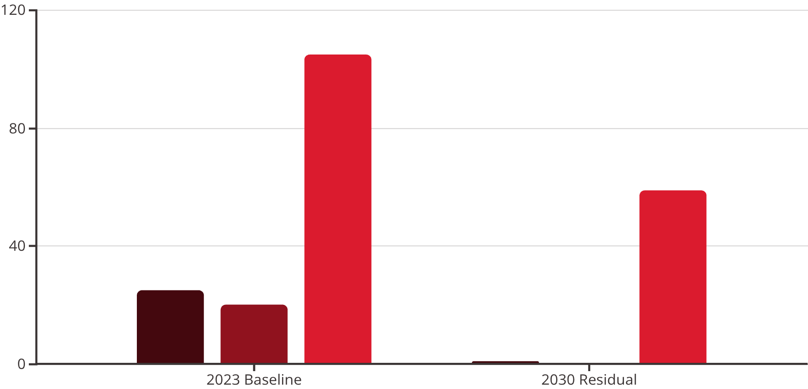

Baseline Emissions and 2030 Target
Our 2023 baseline establishes a comprehensive emissions footprint of 150 ktCO2e across all three scopes. Scope 3 represents the largest opportunity, driven primarily by purchased materials and upstream transportation. Scope 1 and 2 emissions, while smaller in absolute terms, offer the fastest and most controllable abatement pathways through on-site efficiency and renewable energy procurement.
By 2030, aggressive abatement measures will reduce total emissions to 60 ktCO2e—a 90 ktCO2e reduction representing 60% absolute reduction from baseline. The remaining 60 ktCO2e of residual emissions will be neutralized through high-durability carbon removal solutions, including mineralization and bioenergy with carbon capture and storage (BECCS), secured via phased offtake contracts beginning in 2026.
Scope 1
Scope 2 (location)
Scope 3
Neutralization Strategy: The residual 60 ktCO2e in 2030 will be neutralized with high-durability carbon removals (mineralization and BECCS) through phased offtake contracts starting in 2026, ensuring credible net-zero claims aligned with emerging climate disclosure standards.
Note: Scope 2 baseline shown on a location-based accounting method; market-based Scope 2 will reach effectively zero by 2027 through 100% renewable electricity procurement.

Slide 4
Abatement Levers and MAC Curve
This marginal abatement cost (MAC) curve ranks twelve prioritized decarbonization levers by their cost per tonne of CO2e avoided. Bar width represents the volume of abatement each lever delivers annually by 2030, while vertical position indicates cost-effectiveness. Measures below the zero line generate net savings; those above require investment but deliver critical emissions reductions.
Key insight: 62% of total abatement volume (56 ktCO2e/yr) comes from cost-saving or near-zero-cost initiatives, primarily energy efficiency upgrades and renewable energy procurement. These "no-regrets" measures should be prioritized for immediate execution, creating cash flow to fund higher-cost levers like supplier engagement and material substitution.
Scope 1 & 2 (Direct Control)
Scope 3 (Value Chain)
Economic Profile
Energy efficiency: motors, VFDs, HVAC, lighting
Logistics optimization & modal shift to rail
Cost estimates reflect 2025 USD before incentives and exclude any internal carbon price. Compressed air optimization delivers the strongest ROI at -$70/tCO2e, while supplier decarbonization programs carry the highest cost at $30/tCO2e but unlock the largest single volume of abatement.
Compressed air & steam optimization
Supplier decarbonization programs aligned to SBTi
Process electrification: boilers, ovens, dryers
Material substitution & recycled content integration
On-site solar + battery storage
Renewable PPAs & green tariffs
Waste reduction & circular economy initiatives
Waste heat recovery systems
Implementation phasing begins in 2024 for quick wins, with full deployment of all levers by 2030.
Fleet electrification: yard trucks & light-duty vehicles
Packaging optimization & lightweighting

Slide 5

100% Renewable Electricity: PPAs + On-Site Generation
Procurement Portfolio
Transition Timeline
On-Site PV: 5 MWdc rooftop and ground-mount installation generating approximately 6.5 GWh annually from 2026. System paired with 2 MWh / 1 MW battery storage for peak demand shaving and tariff optimization.
Electricity demand grows from 58 GWh in 2024 to 75 GWh by 2030, driven primarily by process electrification initiatives. Renewable share climbs from 30% today to 100% by 2027, two years ahead of science-based target requirements.
Virtual PPA: 50 GWh/yr wind and solar virtual power purchase agreement launching in 2027 with 10-year tenor. Hub-settled with baseload delivery profile to match facility load characteristics.
The diversified procurement strategy balances cost, risk, and additionality. On-site generation provides price certainty and visible sustainability credentials. The VPPA locks in competitive pricing while supporting new renewable capacity. Green tariff fills gaps and provides flexibility as demand evolves.
Green Tariff & EACs: Utility green tariff and energy attribute certificates (EACs) provide top-up to 100% renewable supply. Volume ranges from 3.5–18.5 GWh/yr depending on demand fluctuations. Prior to VPPA start, green tariff supplies 30–70% of renewable mix.
Commercial structure: VPPA uses hub-based financial settlement to avoid congestion risk. Strike price approximately $32/MWh vs. current grid price of $55/MWh, generating $1.15M in annual savings.

Slide 6

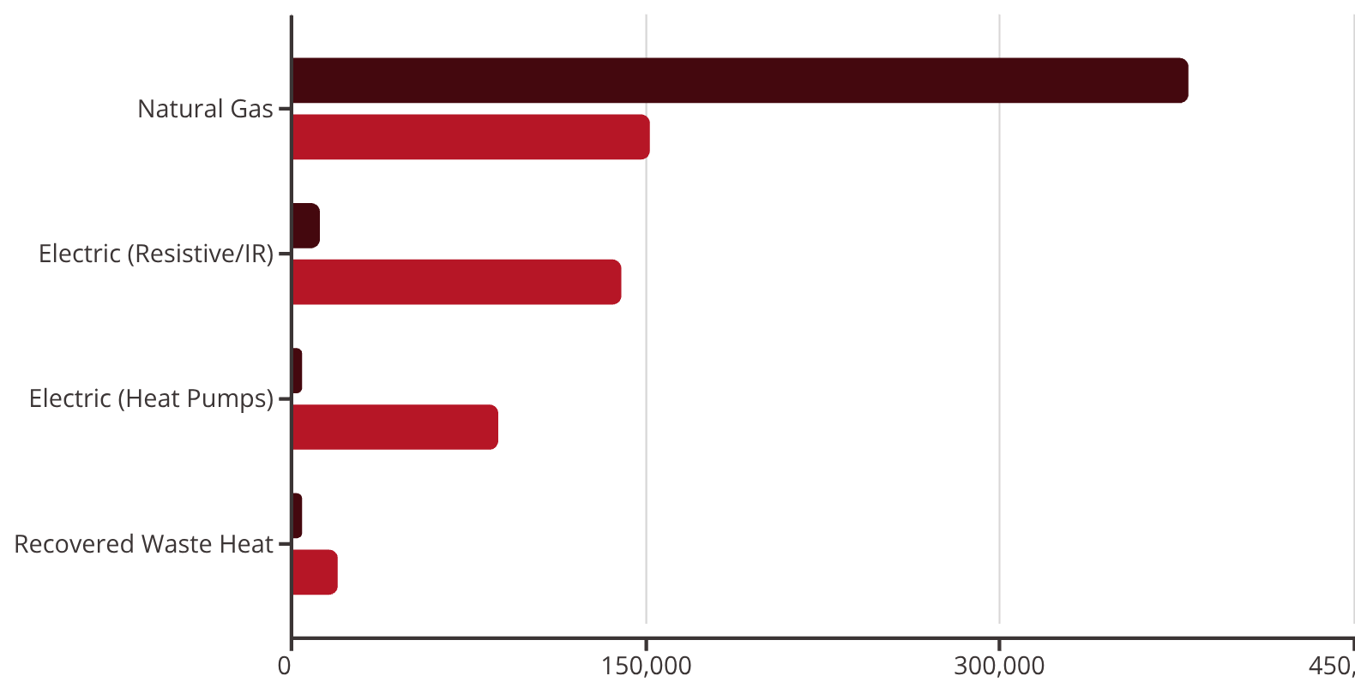
Process Electrification Roadmap
Electrifying industrial process heat represents the single largest technical challenge in this roadmap. Our baseline process heat demand of 400,000 MMBtu/yr comes primarily from natural gas-fired boilers, ovens, and dryers operating across a range of temperature zones. The 2030 target: electrify 60% of low- and medium-temperature heat loads, pilot one high-temperature production line with electric alternatives, and integrate 20,000 MMBtu/yr of recovered waste heat back into the process.
Electric Boilers
Heat Pumps
Four 3 MW electric boilers for steam and hot water generation, replacing gas-fired units in phases. Enables rapid response and zonal control while eliminating combustion emissions.
Six 1.2 MW industrial heat pumps (COP 2.5–3.0) serving low-temperature processes below 120°C. Highly efficient thermal upgrade from waste heat and ambient sources.
Electric IR Ovens
Thermal Storage
Three electric infrared and convective ovens (1.5–2 MW each) with advanced zonal control. Faster heat-up, tighter tolerances, and improved product quality vs. gas-fired alternatives.
4 MWhth thermal energy storage enables load shifting to off-peak hours, reducing demand charges and maximizing renewable energy utilization during high-solar periods.
Phased Implementation
2024–2025: Engineering & Pilots. Complete front-end engineering design (FEED) studies for all major equipment. Run pilot installations on one dryer line to validate performance, tune controls, and build operator confidence. Secure utility interconnection upgrades to handle increased electrical load.
2026–2027: Phase 1 Deployment. Install two electric boilers and three industrial heat pumps. Commission advanced control systems and conduct extensive performance verification. Train operators and refine standard operating procedures.
2028–2030: Phase 2 Scale-Up. Complete installation of remaining boilers and heat pumps. Deploy all three electric IR ovens with integrated waste-heat recovery loops. Achieve full 60% electrification target by year-end 2030.
2023
2030
Process heat supply mix transformation: 60% of low/medium-temp heat electrified by 2030.

Slide 7
Economics: Capex, Opex, and Payback
Financial discipline anchors this decarbonization roadmap. Every initiative has been evaluated using a consistent set of assumptions: 8% weighted average cost of capital (WACC), $55/MWh electricity price, $6/MMBtu natural gas, and a $75/tCO2e shadow carbon price with 2% annual escalation. These conservative assumptions ensure robust returns even if commodity prices or policy incentives shift.
Initiative
Capex ($M)
Annual Savings ($M)
Abatement (ktCO2e)
Payback (yrs)
Notes
LED + Controls
1.2
0.25
1.5
4.8
Utility rebates up to 20% capex
VFDs & Motor Optimization
1.0
0.40
2.2
2.5
ISO 50001 alignment
Compressed Air Program
0.4
0.50
3.3
0.8
Leak remediation + controls
On-site PV (5 MWdc + 2 MWh)
6.5
0.55
2.5
8.0
48E ITC 30% → net ~$4.55M
VPPA (50 GWh/yr, 10-yr)
0.0
1.15
12.5
0.0
Strike ~$32/MWh vs $55/MWh BAU
Process Electrification
12.0
1.20
10.0
10.0
Subject to demand charges; thermal storage mitigation
Waste Heat Recovery
4.0
0.70
4.0
5.7
Eligible for industrial efficiency grants
Fleet Electrification
1.5
0.18
2.0
8.3
Charger incentives may improve payback
Logistics Optimization
0.8
0.90
5.0
0.9
TMS + mode shift to rail
Supplier Program
0.0
0.0
25.0
N/A
Opex ~$2M/yr; ROI via resilience & CBAM premium
Portfolio view: Total capital investment of approximately $27.4M (before incentives) generates $5.83M in annual operating savings and delivers 67.5 ktCO2e of abatement by 2030. Blended simple payback of 4.7 years improves to under 3 years after applying available tax credits and grants. The VPPA and compressed air program deliver immediate positive cash flow, funding higher-capex electrification investments.

Slide 8
Incentives and Funding by Region
Policy support for industrial decarbonization has accelerated dramatically over the past 24 months. From the U.S. Inflation Reduction Act to EU Innovation Fund grants, manufacturers can now access billions in tax credits, direct grants, and concessional financing. Navigating this landscape requires careful attention to eligibility rules, stacking limitations, and reporting requirements. The incentives outlined below can reduce net project costs by 25–50% for qualifying investments.
United States
IRA 48E Clean Electricity ITC: 30% investment tax credit (up to 50% with energy community and domestic content adders) for on-site solar and storage. Applies when prevailing wage and apprenticeship requirements are met. Direct-pay option available for tax-exempt entities.
DOE Industrial Decarbonization Grants: $5M–$500M competitive grants focused on electrification, heat pumps, and waste heat recovery in energy-intensive industries.
Section 179D: Energy-efficient commercial building deduction up to $5.00/sq ft for lighting, HVAC, and envelope upgrades meeting efficiency thresholds.
European Union
EU Innovation Fund / CEF: Grants covering up to 60% of capex and opex for large-scale industrial decarbonization pilots, particularly electrification and waste heat projects.
REPowerEU / National Schemes: Country-specific programs offering 10–55% capex grants (e.g., Germany EEW, France ADEME), subject to state-aid rules and caps.
EU ETS / CBAM Readiness: Avoided carbon costs and funding from ETS auction revenues. CBAM reporting now in transition; full cost exposure begins 2026.
United Kingdom
Industrial Energy Transformation Fund (IETF): 30–65% capex support for efficiency improvements and fuel-switching projects. Electrification and process heat eligible.
Full Expensing (Capital Allowances): 100% first-year tax deduction on qualifying capital equipment, substantially improving project NPV.
Canada
Clean Technology ITC: 30% investment tax credit for solar, wind, storage, and heat pumps. Includes phase-down schedule; early action maximizes value.
SIF / NRCan Industrial Programs: Grants and concessional loans for industrial decarbonization, supporting electrification and energy efficiency at scale.
Japan
Green Growth Strategy Subsidies: Up to 50% funding for industrial electrification pilots. Coordinates with utility green tariff programs to enable renewable-powered manufacturing.
India
Accelerated Depreciation (RE): Up to 40% accelerated depreciation for renewable energy assets. Availability varies by state DISCOM.
PLI / Industrial Efficiency Schemes: Targeted incentives for manufacturing upgrades tied to production-linked performance. Eligibility criteria vary by program.
Critical note: Confirm current eligibility, prevailing wage requirements, domestic content rules, and state-aid limitations with legal and tax advisors prior to final investment commitment. Incentive rules evolve rapidly and vary significantly by jurisdiction.

Slide 9
Key Risks and Mitigations
No decarbonization roadmap of this scale is without risk. Technical performance shortfalls, supply chain disruptions, policy changes, and organizational resistance can derail execution or erode returns. The risk matrix below identifies six priority threats, assessed for likelihood and potential impact. Each has a clear mitigation plan and executive owner accountable for monitoring and response.
A. Electrification Performance Shortfall
B. PPA Basis/Price Risk and Counterparty Credit
Risk: Electric boilers, heat pumps, or ovens fail to achieve design temperature, throughput, or product quality specifications.
Risk: VPPA exposes facility to basis risk between hub settlement and local pricing. Counterparty credit deterioration threatens contract performance.
Likelihood: Medium | Impact: High
Likelihood: Medium | Impact: Medium-High
Mitigation: Pilot installations on one production line before full-scale rollout. Include fallback gas trim burners for critical processes. Deploy thermal storage to buffer load variability. Secure vendor performance guarantees with liquidated damages.
Mitigation: Conduct detailed hub selection and basis risk analysis before contract execution. Add financial basis hedge if exposure exceeds tolerance. Run multi-seller RFP to ensure competitive terms. Purchase credit insurance or require parent guarantee.
Owner: VP Operations
Owner: CFO / Energy Procurement
C. Capex Overrun and Schedule Slip
D. Long-Lead Equipment Delays
Risk: Complex multi-year projects exceed budget or miss critical milestones, delaying emissions reductions and eroding ROI.
Risk: Transformers, switchgear, and custom electric process equipment face 12–18 month lead times, threatening schedule.
Likelihood: Medium | Impact: High
Likelihood: High | Impact: Medium
Mitigation: Use EPC-wrapped contracts with fixed-price guarantees where feasible. Hold 15% contingency budget. Require stage-gate FEED with board approval before notice-to-proceed. Implement weekly PMO controls and earned-value tracking.
Mitigation: Place early procurement orders (NTP by Q4 2024) even before full project funding. Qualify multiple equipment vendors to avoid single-source dependency. Maintain access to temporary rental equipment for critical path items.
Owner: Program Management Office
Owner: Supply Chain
E. Policy/EAC Claim Changes
F. Change Management & Operator Adoption
Risk: Renewable energy certificate (REC) quality standards or additionality requirements evolve, potentially invalidating emissions accounting claims.
Risk: Plant operators resist new electric equipment, leading to suboptimal performance, safety incidents, or reversion to legacy gas systems.
Likelihood: Medium | Impact: Medium
Likelihood: Medium | Impact: Medium
Mitigation: Prioritize bundled VPPA structures over unbundled EACs to maximize additionality credibility. Align renewable procurement with GHG Protocol Scope 2 Guidance and emerging best practices. Conduct annual third-party limited assurance of renewable claims.
Mitigation: Launch formal training programs for all affected operators. Update standard operating procedures (SOPs) and work instructions. Tie plant-level incentive compensation to equipment adoption and energy KPIs. Run kaizen events to capture operator feedback and iterate.
Owner: Sustainability
Owner: Plant Manager
Executive accountability is critical. Each risk owner reports monthly to the Steering Committee on status, early warning indicators, and mitigation execution. The risk register is a living document, updated quarterly as the program progresses and new threats emerge.

Slide 10
Governance and KPI Dashboard
Effective governance transforms ambition into execution. This roadmap establishes a clear command structure, empowered workstreams, and real-time performance tracking to ensure accountability at every level. The governance model balances strategic oversight with operational agility, enabling rapid decision-making while maintaining board-level visibility.
Governance Model
Key Performance Indicators
Steering Committee: CEO (chair), CFO, COO, VP Sustainability, VP Supply Chain. Meets monthly to review progress, resolve roadblocks, approve major expenditures, and maintain alignment with corporate strategy. Escalation path for issues beyond PMO authority.
KPI
Baseline
2025
2030
Frequency
Total emissions (ktCO2e, Scopes 1–3)
150
120
0
Quarterly
Program Management Office: Head of Decarbonization plus dedicated site project managers. Weekly cadence to track workstream execution, manage cross-dependencies, and monitor budget and schedule adherence. Single source of truth for program status reporting.
Scopes 1+2 market-based (ktCO2e)
45
25
0
Monthly
Workstreams: Five parallel execution tracks—Efficiency, Energy Procurement, Electrification, Supplier/Scope 3, Data & Reporting—each led by a functional SME with clear deliverables and timelines.
Assurance: Annual third-party verification of emissions data and renewable energy claims, transitioning from limited assurance today to reasonable assurance by 2028 as data systems mature.
Renewable electricity share (%)
22
45
100
Monthly
Energy intensity (kWh/unit output)
12
10
8
Quarterly
Supplier coverage (% spend w/ SBTi targets)
15
40
80
Quarterly
Project schedule adherence (%)
—
90
95
Monthly
All KPIs auto-refresh monthly from integrated energy management and ERP systems, ensuring data accuracy and reducing manual reporting burden. Targets are aligned to science-based trajectories and communicated transparently to employees, investors, and key customers.

Slide 11

6-Quarter Execution Plan (Q1 2024 – Q2 2026)
The first eighteen months establish the foundation for long-term success: governance structures, baseline data, regulatory approvals, and early wins that build organizational momentum. This Gantt chart maps the critical path across nine parallel workstreams, with dependencies clearly marked. Milestone diamonds represent go/no-go decision points requiring Steering Committee approval.
Q1 2024: Foundation
1
Steering Committee charter finalized. Data collection and baseline verification launched. Efficiency wave 1 (compressed air leak survey, LED audits) mobilized. Supplier engagement code drafted.
2
Q2 2024: Procurement Launch
VPPA RFP issued to 8–10 qualified developers. On-site solar feasibility study and preliminary design completed. Process electrification FEED studies kick off for Phase 1 equipment.
Q3 2024: SBTi Submission
3
Science-Based Targets initiative (SBTi) near-term and net-zero targets submitted for validation. EPC contractor shortlisted for solar project. Utility interconnection application submitted. Efficiency wave 2 installations begin.
4
Q4 2024: VPPA Decision
Board go/no-go on VPPA execution. If approved, contract signed with preferred developer. On-site solar EPC award and notice-to-proceed. Supplier code of conduct issued to top 50 vendors by spend. Risk register goes live.
Q1 2025: Solar Construction
5
On-site solar construction begins (6-month build). FEED studies for electrification complete; Phase 1 equipment procurement launched. Fleet electrification pilot (5 vehicles) deployed.
6
Q2 2026: First Electric Line
On-site solar commercial operation date (COD). First electrified process line (pilot dryer) commissioned and performance-tested. Waste heat recovery engineering complete. 80% of supplier spend covered by engagement program. Efficiency waves 1–3 fully deployed.
Critical dependencies: Utility interconnection approvals must precede electrification installs (Q3 2024 → Q1 2025). VPPA execution must occur before claiming 100% renewable electricity (Q4 2024 → Q1 2027). Supplier code issuance precedes meaningful Scope 3 reductions (Q4 2024 → ongoing).
Weekly PMO meetings track progress against this plan, with red/yellow/green status reporting to the Steering Committee. Any workstream slipping more than two weeks triggers escalation and corrective action.

Slide 12




Call to Action
This roadmap is comprehensive, credible, and ready for execution. The path to net-zero by 2030 is clear: 90 ktCO2e in annual abatement, 60 ktCO2e neutralized with durable removals, and resilient economics that strengthen competitiveness. But planning ends where action begins. The next 90 days will determine whether this roadmap becomes a strategic advantage or remains a shelf document.
Within 30 Days
Finalize governance charter and nominate Steering Committee members. Approve VPPA request-for-proposal and issue to qualified developers. Kick off compressed air leak survey and LED lighting audits at priority facilities.
Within 60 Days
Shortlist VPPA bids based on price, credit quality, and commercial terms. Complete front-end engineering design (FEED) for Phase 1 electrification equipment. Secure position in utility interconnection queue for on-site solar and increased electrical load.
Within 90 Days
Board go/no-go decision on VPPA execution. Lock in available incentives: IRA 48E investment tax credit applications, state/regional grant submissions. Mobilize wave-1 efficiency work orders (motors, compressed air, lighting). Establish risk register with executive ownership.
By Year-End 2024
Execute VPPA with preferred developer. Issue notice-to-proceed for on-site solar EPC contractor. Distribute supplier code of conduct to top 50 vendors by spend, requiring SBTi target commitments or detailed roadmaps. Risk register live and reported monthly to Steering Committee.
Scopes 1+2 Net-Zero by 202790 kt Abatement by 203060 kt Neutralized via Durable Removals
The roadmap is ready. The time to act is now.

